Slide 1
Introduction to JavaScript

Slide 2
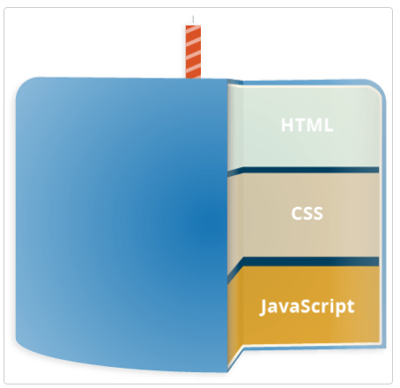
What JavaScript Is?

Slide 3
What JavaScript Is Not?
JavaScript is not Java.
It Cannot Write to Files on the Server Without the Help of a Server-Side Script.
It Cannot Read From or Write to Files in the Client.
It Cannot Access Web Pages Hosted on Another Domain.
It Cannot Protect Your Page Source or Images.

Slide 4
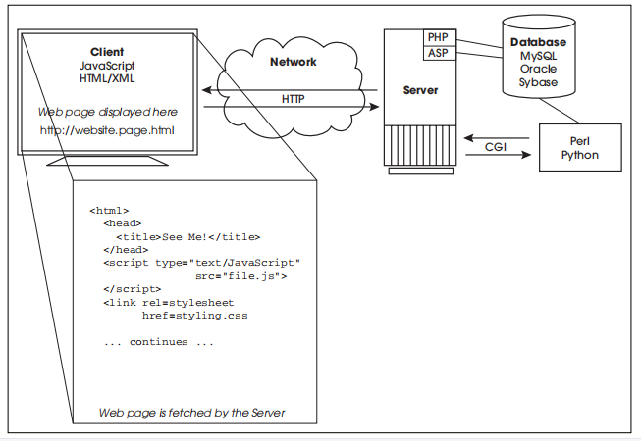
JavaScript and Its Place in a Web Page

Slide 5
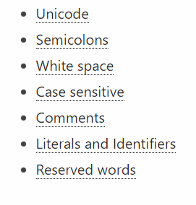
The Lexical Structure of JavaScript

